Slide 1
Hyperspectral Image Classification Using ResNeXt with Squeeze and Excitation Block
Jiayu Wang
Notes:
Hello, my name, my project name.

Slide 2

Executive Summary
Project Intention:
Classify hyperspectral images between five classes: almond, amber, shell, stone, and wood chip.
Notes:
say project intention

Slide 3
Notes:
show and say class name

Slide 8

Executive Summary
Accomplished tasks:
Data preprocessing
Neural network building
Training and testing
Results plotting
Notes:
I have accomplished ….

Slide 9

Executive Summary
Brief assessment of success:
Followed the proposal, made slight changes and finally achieved what I hoped for.
Notes:
While I was doing the project, I ….

Slide 10
Approaches
Notes:
Data is from a company called Middleton Spectral Vision, where I currently work as an intern.
First I used a program written earlier for work to crop original images into same-size subimages containing a single object.
Then I wrote a Python program to extract image data of all subimages and format it as needed for the network input.
These RGB images are formed by extracting the RGB channel of raw images.
HS images contain more than 400 spectral channels, ranging from about 400nm to 1000nm.

Slide 11
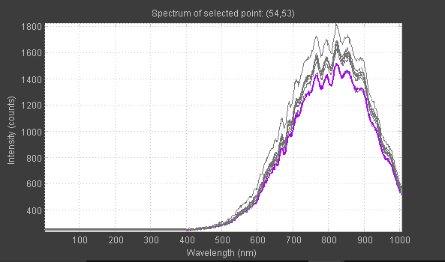
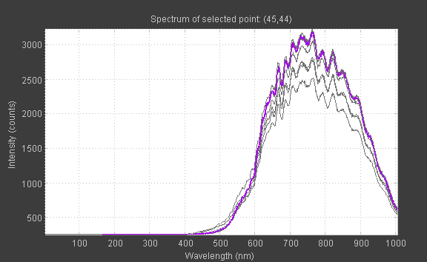
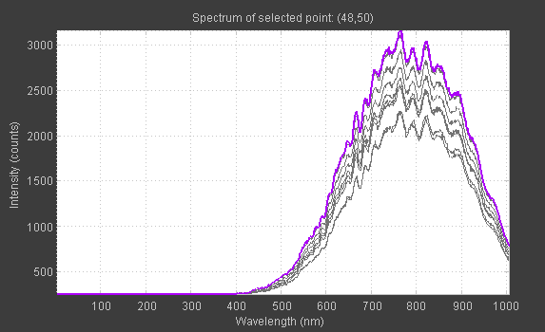
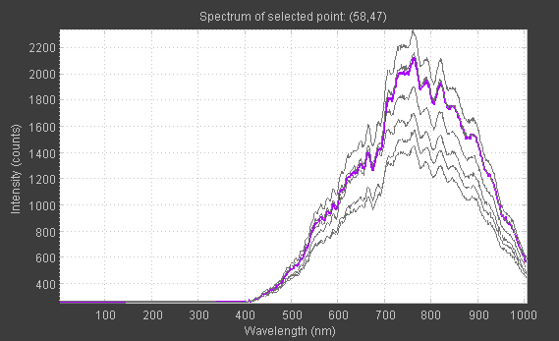
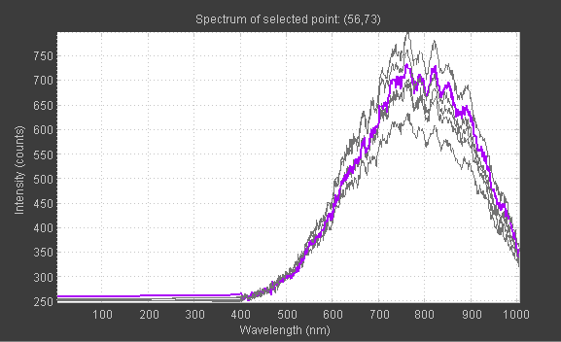
Notes:
A quick view of that… Each curve represents the spectral data of one pixel on the graph.
Name five classes, point to differences in spectral curves.

Slide 12
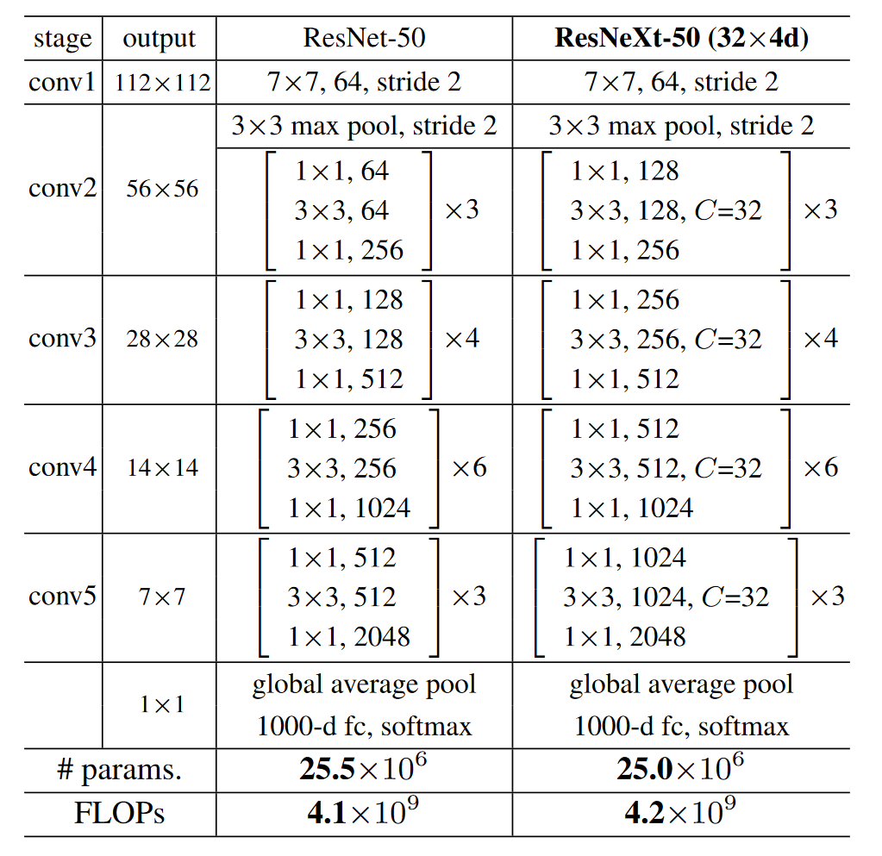
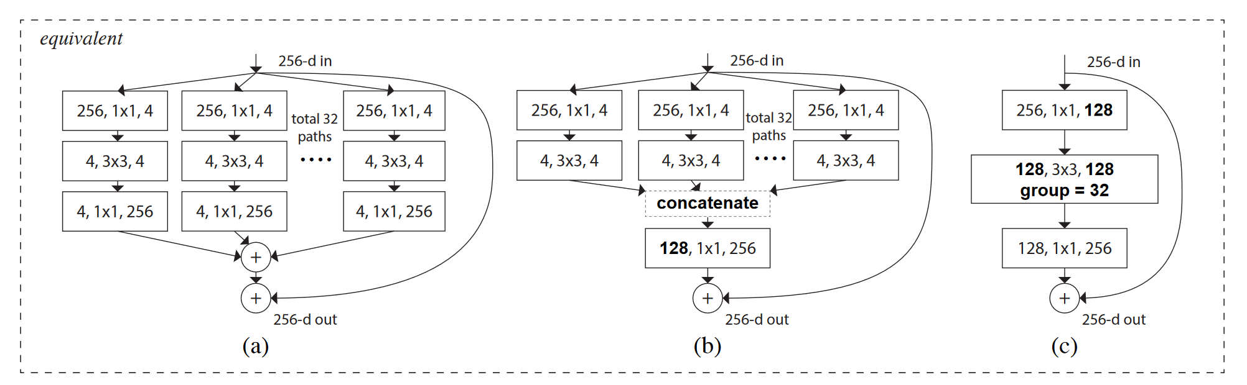
Approaches
ResNeXt with Squeeze & Excitation block
[1]
[1]
Notes:
This is the ResNeXt. It’s based on ResNet, except it splits the path in ResNet into many small ones and recombines them.
The number of splitting is called cardinality.

Slide 13
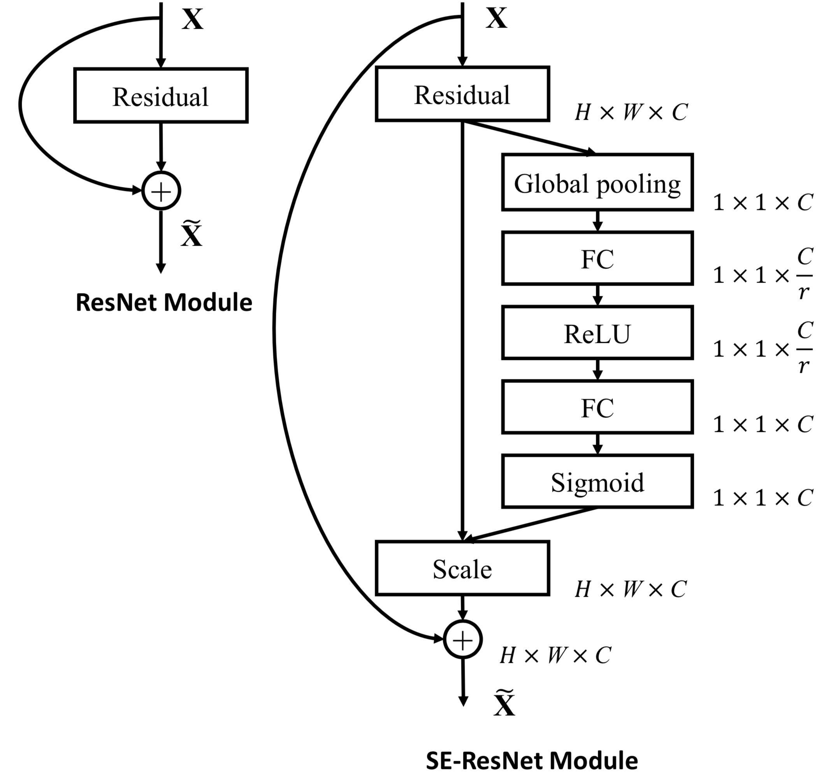
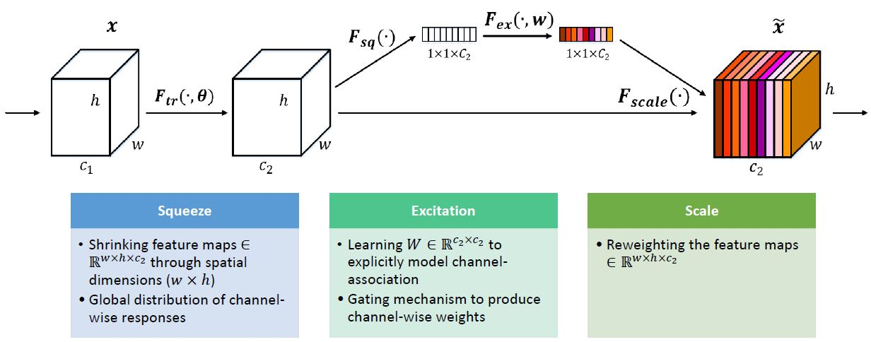
Approaches
ResNeXt with Squeeze & Excitation block
[2]
[2]
Notes:
This is the squeeze and excitation block. It’s a performance improvement block that can be added into any architecture.
It adds a path which reduces dimensionality, gates the data, and expands back.
Originally I planned to implement ResNet with S&E block but didn’t work out.
So I turned to an existing implementation of ResNeXt with S&E block.

Slide 14
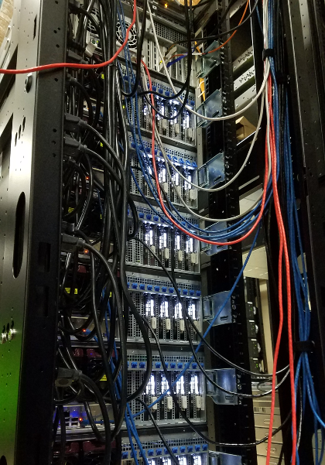
Approaches
Platform: Euler
Configuration:
7 GPUs: GTX TITAN X, each with ~11GB memory.
8 CPUs.
Maximum hardware resources available for request for a single job in the student partition.
Run for 30min for each model and data combo.
[Picture from Euler website]
Notes:
I used euler as my platform.
I requested these many hardware resources in order to run my project, because the data and the network required huge amount of memory.
I tweaked cardinality, number of ResNet building blocks, and number of spectral channels to use in my data to form different combinations of model and input data.
Each combo runs for 30min.

Slide 15
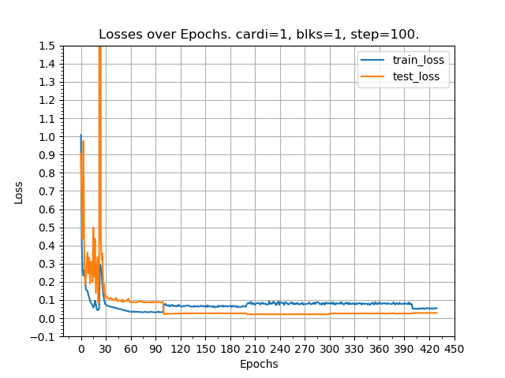
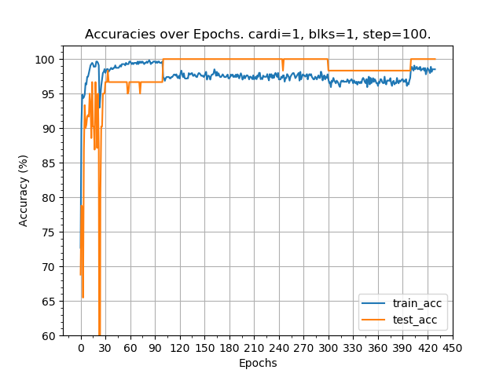
Results
Notes:
Showing you the results of the least powerful model and input data that has only 2 more channels than RGB.
The results are very good.
In 30 mins, it ran for more than 400 epochs.
But after 30 epochs or so, the max performance was already achieved.

Slide 16
Discussion
Use existing implementations whenever possible.
Simplify model and down sample data when computation resources are limited.
Even simplified neural network model can be very powerful.
Notes:
Read three learned lessons.

Slide 17
Reference
[1] S. Xie, R. Girshick, P. Dollár, Z. Tu, and K. He, “Aggregated Residual Transformations for Deep Neural Networks,” arXiv:1611.05431 [cs], Nov. 2016.
[2] J. Hu, L. Shen, and G. Sun, “Squeeze-and-Excitation Networks,” arXiv:1709.01507 [cs], Sep. 2017.

